Slide 1
CCA – PCA & Confidence c 03rd Nov 2016

Slide 2
Current Stats
# Of training descriptions | # Of features from BOW+W2V | # Of Features after cleaning | Time Taken
6780 | 4292 | 910 | 15 min
15000 | 7745 | 898 | 40 min
35000 | 10800 | 890 | 3926 min
Currently features are extracted from Bag Of Words (BOW) and Word2Vec (W2V)
Number of BOW features ∝ Number of training descriptions
Number of W2V (generic) features = 149 (fixed)
Currently Feature cleaning involves:
Removing Zero Variance features (Configurable cut-off of 0.03)
Removing Pair-wise correlated features (Configurable cut-off of 1)
With growing number of training descriptions, feature cleaning is taking very long
The scope of this document is to explore options for dimensionality reduction on large datasets

Slide 3
Dimensionality reduction techniques:
Principal Component Analysis (PCA):
sklearn.decomposition.PCA looks for a combination of features that capture well the variance of the original features. Linear dimensionality reduction using Singular Value Decomposition of the data to project it to a lower dimensional space.
The issue with PCA however is that we will loose out on the Feature Importance per charge class description.

Slide 4
Comparison of techniques:
Column1 | Current (PWC) | PCA_90_Run1 | PCA_90_Run2 | PCA_99
Number of features selected | 912 | 618 | 618 | 1971
Time for cleaning by PWC/PCA (sec) | 159.9299941 | 58.97085595 | 54.66009808 | 59.25737906
Time for training classifiers (sec) | 647.202193 | 498.7321892 | 572.717412 | 1543.589445
Total time for learning (sec) | 898.1960709 | 654.396553 | 723.7728341 | 1768.15386
Accuracy | 86.729 | 87.04 | 87.04 | 87.921
Precision | 86.756 | 86.821 | 86.821 | 87.519
Recall | 86.729 | 87.04 | 87.04 | 87.921

Slide 5
Confidence Calculation:
We are getting 9 classifications (including Jaro) along with respective 9 probabilities.
We are doing simple voting on the nine classifications to get voted output. Wherever a tie is encountered, the average probability decides the voted output.
To compute the overall confidence, we are calculating binary columns for each classifier. If the classified charge class matches with voted charge class then its 1 otherwise 0.
Confidence Score = ∑ (Probability x Binary)/No. of classifiers

Slide 6
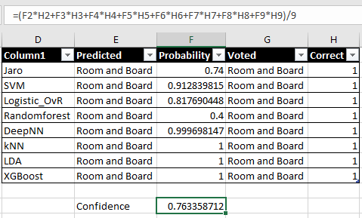
Confidence Calculation Example 1:
03600007 - RB 4 WEST ICU SURG

Slide 7
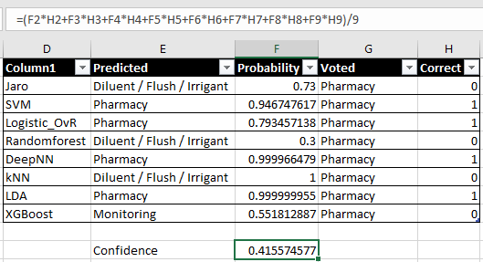
Confidence Calculation Example 2:
D5W 1/2NS 1000ML/20MEQ KCL

Slide 8
Thank You

